Slide 1
MODELLING HAZARD POINTERS
LECTURER:
Prof. Dr. Vitaliy Mezhuyev
GROUP MEMBER:
Syed Nabil Naim bin Syed Mohd Amudin CB14010
Amirah Binti Mohamad CB14018
Khairunnisa Binti Che Hassan CB14139
Lakhvinder Kaur Mahinder Singh CB141136

Slide 2
INTRODUCTION
Hazard pointers are one approach to solving the problems posed by dynamic memory management of the nodes in a lock-free data structure.
Arise only in environments that don't have automatic garbage collection Any lock-free data structure that uses the compare-and-swap primitive must deal with the ABA problem.
In a hazard-pointer system, each thread keeps a list of hazard pointers indicating which nodes the thread is currently accessing.
Nodes on the hazard pointer list must not be modified or deal located by any other thread.
Each reader thread owns a single-writer/multi-reader shared pointer called "hazard pointer."

Slide 3
PROBLEM STATEMENT
The condition of at least one node of the hazard pointer has be continuously holding that reference from the period where the node was definitely safe for the thread.
Complier sometimes not clear to determine whether the node is no longer reachable.
How to allow the removed nodes to be free up based on the memory reclamation access.

Slide 4
BENEFIT OF HAZARD POINTER
Offer significant performance and reliability advantages over conventional lock-based objects.
Memory management methodology that allows memory reclamation for arbitrary reuse.
Suitable for user-level applications—as well as system programs—without dependence on special kernel or scheduler support.
Requires only single-word reads and writes for memory access in its core operations.
Allows reclaimed memory to be returned to the operating system.
It offers a lock-free solution for the ABA problem using only practical single-word instructions.

Slide 5
TLA

Slide 6

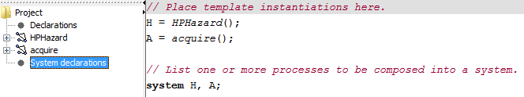
UPPAAL
Hazard Pointer Declaration

Slide 7
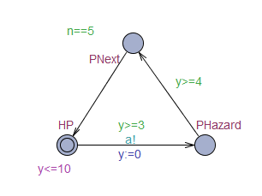
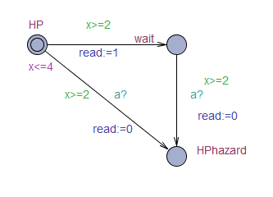
Hazard Pointer Diagram
HPHazard acquire
Figure above shows Hazard Pointer which is involve two templates. First one called HPHazard used to run the basic flow and for the second one called acquire used to check and process if there is reader or not at that time.

Slide 8
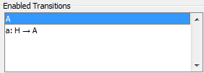
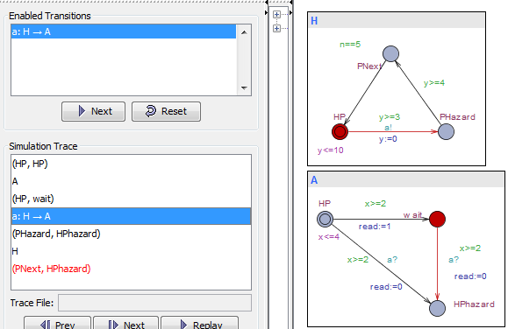
There is two enable transitions that can be apply while running this tools.
Figure above shows the transaction between HP ->wait->HPhazard and PHazard->PNext. These flows occur if
there is at least one reader still reading and have to wait
before delete it.

Slide 9
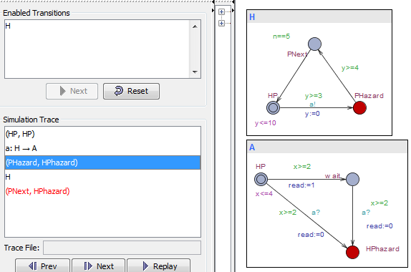
In other transaction, these flows occur when there is no reader still reading and the flow is HP->HPhazard->PNext. It just skips the node waiting and the book can be release without affect anything.

Slide 10
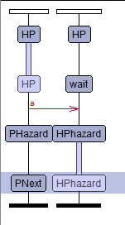
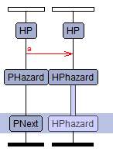
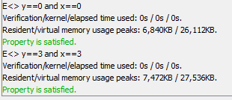
Figure above shows the verifier that had been test. It was satisfied when x and y are equal to 3 or equal to 0. This is follow the rule in HPHazard allowing x<=4 and y<=10.
Read>=1
Read=0

Slide 11
CONCLUSION
We had gained more experiences, important of TLA and Uppal languages and moral values too.
At the same time we also had a great chance to know well about the important of the subject Formal Methods for computer students.
Allows us to improve our knowledge in computer programmed development.
We also learned some vital value of system such as the accuracy, correctness, robustness of the problem using a specific specification.
We also had experiences on the memory which allows to used by consumed nodes to be reclaimed by the OS.
Hazard pointers only require basic a basic CAS or LL/SC instruction.

